Slide 1

Analysis of Job Postings for Data analysts in LinkedIn
Nikhil Mogre
Amith BJ
Chitra Pandey

Slide 2

Objective
To Scrape the data from LinkedIn using Python libraries called Beautiful Soup and Selenium.
To analyse the data and derive the insights.
Procedure
Scraping the Data of about 320 job postings.
Cleaning and Transforming the Data.
Analysis Using Excel visualisation.
Preparing Dashboard.

Slide 3
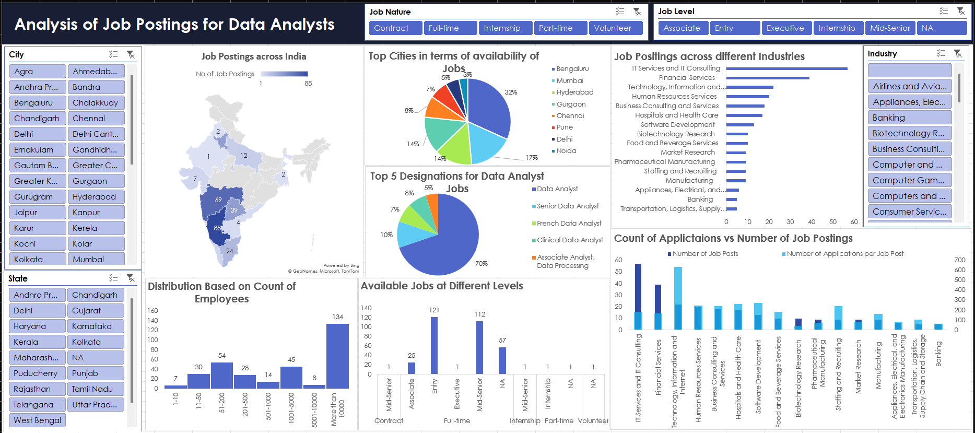

Slide 4
Let’s Understand the Market for the data analyst role In More Depth

Slide 5
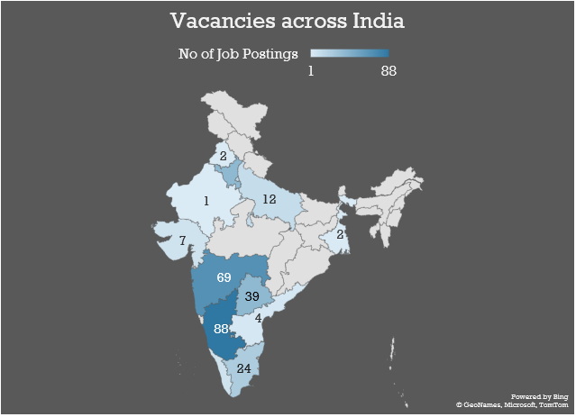
Job Status Across India
Clearly, Karnataka seems to be a hub for the jobs related to data analytics followed by Maharashtra.
In case of Karnataka, almost all job openings are from city Bengaluru.
In case of Maharashtra, there is major split between Mumbai and Pune in terms of vacancies for data analyst job role.

Slide 6
Top Cities to look for job in
Backing up the analysis in the previous slide, we see that Bengaluru has the highest number of job vacancies.
Moreover, we see that comparatively, major cities in South India provides more openings for data analyst role.
Thus, we can declare that South Indian cities hold more scope for data analyst job profile, especially Bengaluru.

Slide 7
What Industry to Look Out For?
This bar chart shows that the maximum openings are from the IT Service and IT Consulting sector.
However, a good potential for data analyst roles can also be seen across Financial Services, Human Resource Services, Business Consulting and Healthcare.
Even industries like Banking, Transportation and Logistics, Manufacturing and Market Research are hiring data analysts.

Slide 8
Most Popular Company Names
Name of Company | Number of followers in LinkedIn
Google | 26730836
IBM | 14623531
Johnson & Johnson | 8101283
The Coca-Cola Company | 7025620
EY | 6841000
PepsiCo | 6839590
Shell | 6003444
Capgemini | 5063467
Citi | 3873397
Hewlett Packard Enterprise | 3515985
JPMorgan Chase & Co. | 3455589
Boston Consulting Group (BCG) | 3426578
GSK | 3400419
HSBC | 3103419
Uber | 2451221
AstraZeneca | 2233858
Airbnb | 2187545
Philips | 2145362
Colgate-Palmolive | 2014342
Confidential | 1940077
This list of popular company names not only reflect their popularity among LinkedIn users, but it also reflects the diversity of industries that require data analysts.
In this list we see a mix of companies from IT industry, financial services, Banking services, Consulting Services, Transportation Services, Consumer goods, etc.
Thus, it is fair to conclude that the requirement for data analysts in the market is high.

Slide 9
Applicants vs job posting
The graph above highlights the competition for jobs in each industry.
It is observed that the maximum competition is in case of Technology, Information and Internet industry where the number of vacancies is comparatively lower for the average number of applications received per job posted on LinkedIn.
Additionally, the IT Services and IT Consulting seems much easier to join as the average number of applications per job posted is quite low.
Similarly, Financial Services sector too exhibits tendency for lower competition.

Slide 10
Who is this job role meant for?
The pie chart shows that most of the job openings are available for a generic data analyst position rather than some specific post.
Along with, there seems to exist a little to no scope for job seekers who aren’t looking for a full-time job position.
Even among the full time opportunities, (ignoring the job posts with no titles, marked with NA) maximum openings are for the entry level followed by mid-senior level job responsibilities.
So, the role seems mostly exclusive of any flexible kind of job but has good opportunities for someone who is looking for full-time opportunities.

Slide 11
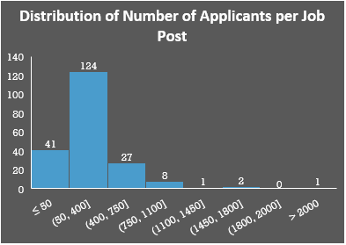
Are you considering Bangalore as the pool of opportunities?

Slide 12
Thank you

